Slide 1
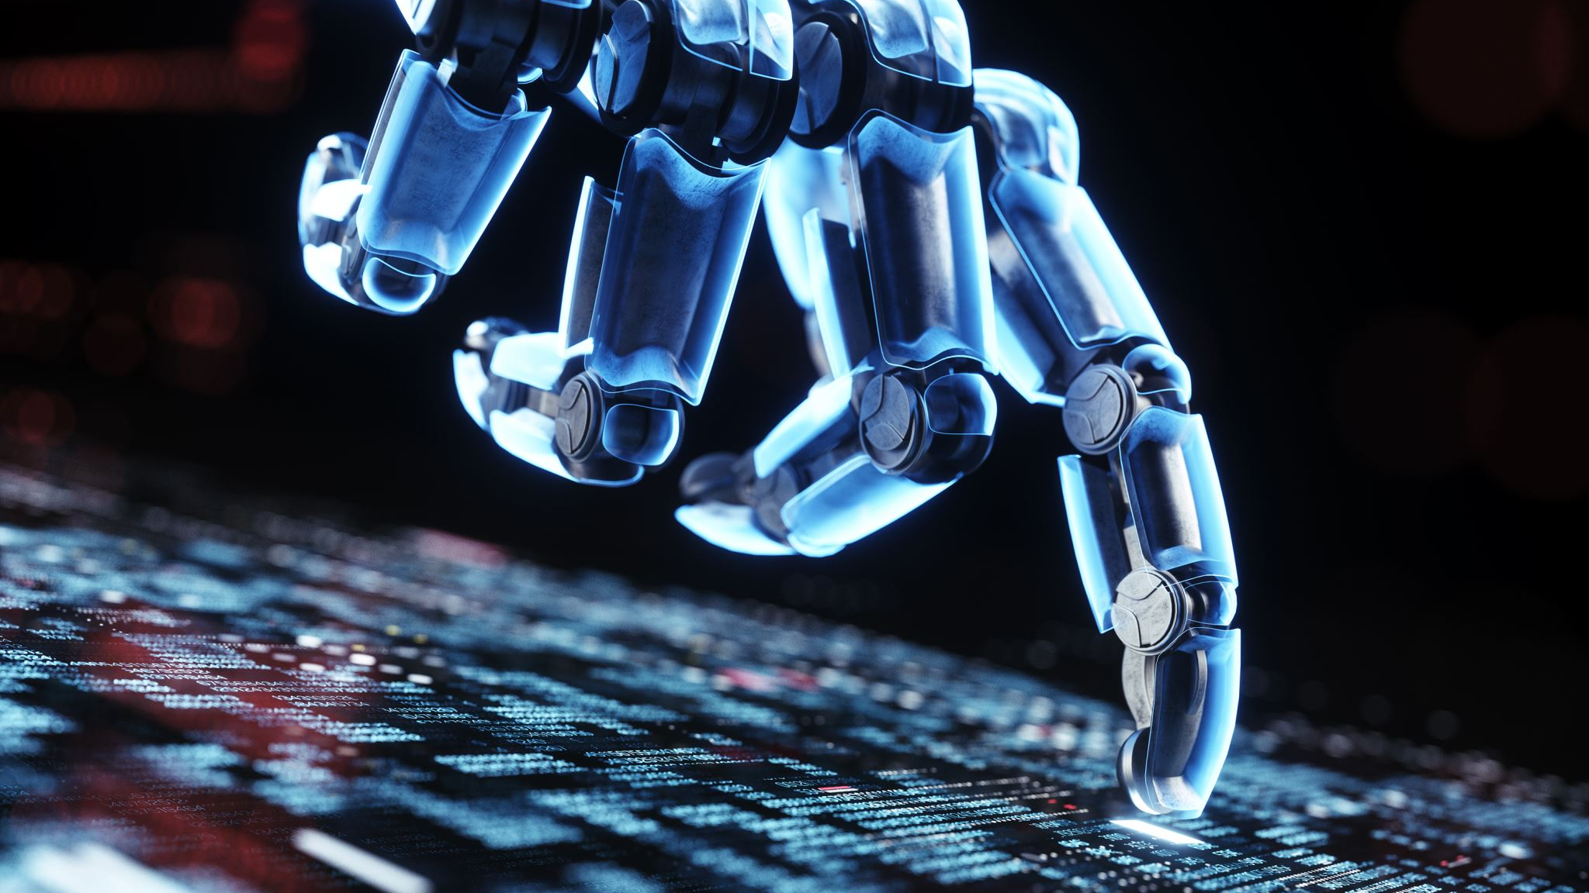
Hands-on-lab1 DDoS-type attacks Recognition with Machine Learning
Oluwafisayo Theophilus

Slide 2
Outline
Introduction to Quantum Machine Learning
Setting Up Your Environment
Basic Quantum Circuits in PennyLane
Quantum Machine Learning Models: Hybrid- Quantum Neural Network (H-QNN)
H-QNN Framework
Conclusion
Reference

Slide 3
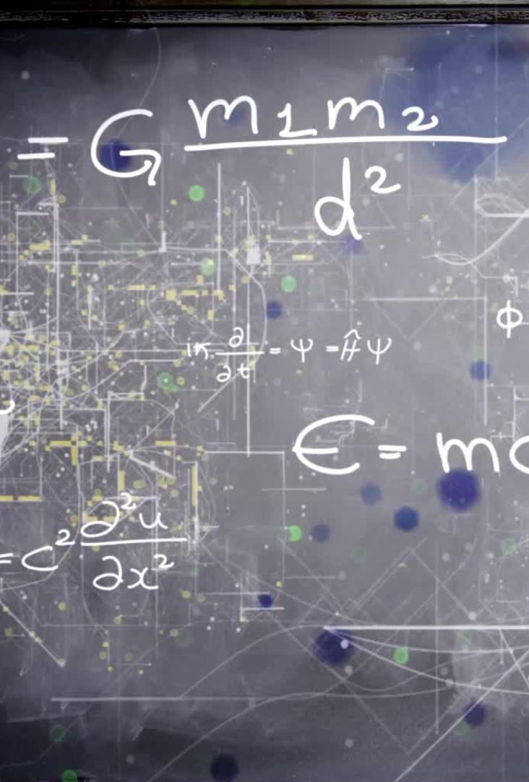
Introduction to Quantum Machine Learning
Before diving into PennyLane, it’s important to understand the basics of Quantum Machine Learning (QML). Here’s what you should know:
Quantum Computing Basics:
Learn about qubits, superposition, entanglement, and quantum gates.
Understand the difference between classical and quantum computing.

Slide 4
Quantum Computing Terms
A quantum circuit is a sequence of quantum gates applied to qubits to perform a computation.
A quantum gate is an operation that changes the state of qubits in a quantum circuit.
The state is changed by a quantum gate to process information or perform a specific computation in a quantum circuit.

Slide 5
Setting Up Your Environment
To work with PennyLane, you need to set up your Python environment.
Install Python: Make sure you have Python installed. PennyLane works well with Python 3.7 and above.
Install PennyLane:
You can install PennyLane using pip: Pip install pennylane
You can use google colab for implementation

Slide 6
Task 1: Basic Quantum Circuits
Here we Simulated the evolution of state zero through the circuit and to simulate the state of the output. These are the steps:
Import pennylane as qml
Define a function
Define our device
Execute the simulation
Draw our circuit

Slide 7
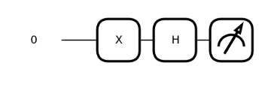
Basic Quantum Circuits in PennyLane
Start by creating simple quantum circuits to understand how quantum computation is implemented in PennyLane.
Understand how to define devices, apply gates, and measure qubits.
Creating a Quantum Circuit:
Example: A simple circuit that applies a Hadamard gate to a qubit
Visualizing Circuits:
PennyLane provides tools to visualize circuits. You can draw a circuit to see what you’re implementing:
pennylane2.ipynb

Slide 8
Tasks: DDoS-type attacks Recognition with H-QNN and DNN
Task 2: Data Preprocessing
Task 3: Training data preparation
Task 4: Hybrid- Quantum Neural Networks (H-QNN) and Deep Neural Network (DNN) models training
Task 5: Model Result Comparison

Slide 9
Quantum Machine Learning Models: Hybrid- Quantum Neural Network (H-QNN)
Now that you are familiar with fundamental circuits, begin developing quantum machine learning models.
Because of their high mistake rates, current quantum devices only allow us to train small quantum models effectively (with as few gates and quantum states as feasible utilizing only a few qubits). Additionally, models that size enable them to be trained in a reasonable amount of time on quantum simulators.
Quantum circuits are used in place of one or more layers in traditional neural networks, or H-QNNs.
In this manner, we may replace, for instance, the dense, microscopic layers at the end of NN with quantum circuits that only require a limited number of qubits, and we can swiftly train them on quantum devices (even with thousands of data points) or simulate them quickly locally.

Slide 10
How can we use a quantum circuit as a quantum layer in a Deep Neural Network?
Input to the quantum state should be encoded (e.g., Angle Embedding).
Utilize ansatz, or a parametrized set of quantum gates, to change the encoded state (Strongly Entangling Layer, for example).
Decode the output of the updated quantum state (find all possible states' (quasi)-probabilities from the measurement and use that information, for example, to compute expectation values).
Qiskit and Pennylane have good, high-level implementations of quantum layers with gradients evaluation. This way we can truly incorporate them into Torch or TensorFlow Neural Network models.

Slide 11
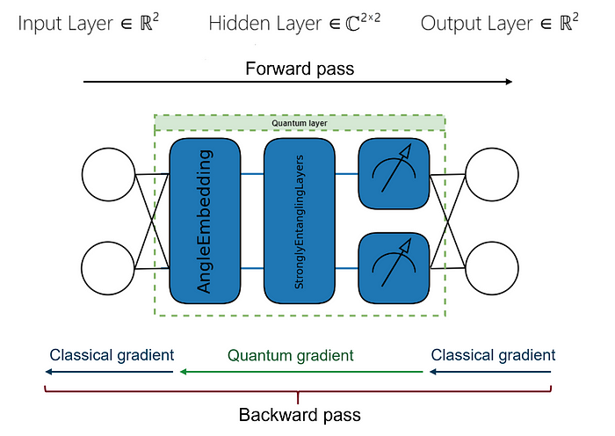
H-QNN Framework
This is a schematic illustration of an H-QNN. It is a two-node Deep Neural Network with one hidden layer switched to a quantum one

Slide 12
Simulation Environment
Qiskit, PennyLane and other Python software development kits provide efficient quantum simulators for classical computers.

Slide 13
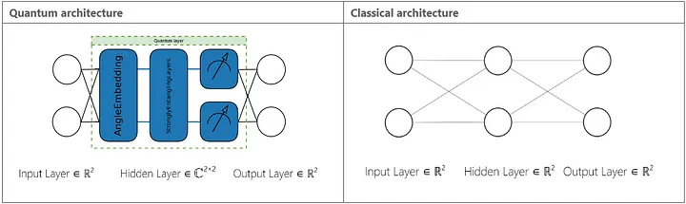
H-QNN and DNN models training:
Angle Embedding is used by the quantum layer to encode the data into a quantum state. Next, since strongly entangling layers are frequently used in QML, we add them. In contrast, we employed a Deep Neural Network (DNN) architecture with a single hidden layer as a classical model. Shape 2 inputs and outputs are present in the input, hidden, and output layers. This is how the data are transformed by the 2-qubits quantum layer in H-QNN, which encodes them into four complex numbers. This enables higher expressivity (i.e., approximating bigger classes of functions) for quantum neural networks.

Slide 14
Quantum layer
A number of high-level wrappers are available from Pennylane for building quantum circuits for Quantum Neural Networks. Afterwards, we will use them to create our Quantum Layer in H-QNN, which is called a qnode (a Pennylane quantum circuit object).
We need to implement:
Classical data encoding: AngleEmbedding, which adds rotation gates for each qubit, will be used for that. We will continue to use the default gate, which is rotation around the X-axis. Two input parameters must be passed in order to specify the gate's rotation angle in this section. To cover all potential qubit states within range (-1, +1), which is the output from the preceding layer with sigmoid activation function, we will scale the input by π.
Trainable ansatz: StronglyEntanglingLayers, which apply three rotations around the z, y, and z axes, respectively, will be used for that. CNOT gates in both conceivable configurations on two qubits are present at the end. We will only use one set, but we are free to apply them as often as we choose.

Slide 15
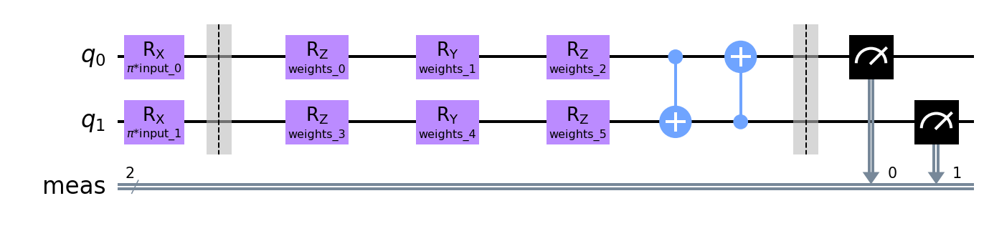
Quantum layer
Data decoding: We'll employ expectation values in the Z basis for data decoding. The most popular approach, which simply adds up the chances of measuring a specific qubit in a state |0> with coefficient 1 and a state |1> with coefficient -1, is this one. As an output, we will receive two numbers in the interval (-1, +1).
Schematically, our quantum layer will resemble this:

Slide 16
Conclusion
The data was prepared for training small, quantum models with dropping some features and We have trained and assessed the hybrid quantum neural network (H-QNN) in this series. We modified a cutting-edge method, providing a robust, compact quantum architecture with significantly less feature-rich data. Since quantum model inference is a primary bottleneck of these systems, this enables us to train and evaluate the model utilizing a far larger number of data points. Our model performed at a high level that was on par with classical analog. Because of the very weak quantum layer and lack of error correction, the code is ready to execute on actual quantum devices.

Slide 17
Reference
1] Quantum machine learning for intrusion detection of distributed denial of service attacks: a comparative overview, E. D. Payares and J. C. Martinez-Santos, 2021
https://medium.com/@marekkowalik97/quantum-machine-learning-for-cybersecurity-part-2-af26b74645fe
https://medium.com/@marekkowalik97/quantum-machine-learning-for-cybersecurity-part-1-7c638c4da98

